Slide 1
AI

Slide 2
Artificial Intelligence
8.2.1 Problem Solving and Search (Ch. 3)

Slide 3
Outline
Problem-solving agents
Problem types
Problem formulation
Example problems
Basic search algorithms

Slide 4
Cops and Robbers
Three cops and three robbers come to a river and find a boat that holds two. If the robbers ever outnumber the cops on either bank, the robbers will overpower the cops and escape.
What is the strategy to cross the river without letting the robbers escape?

Slide 5
Cops and Robbers
State representation?
Start State?
End State?
Transitions?

Slide 6
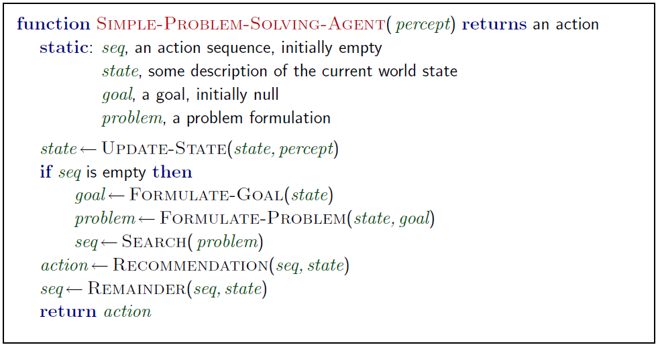
Problem-solving agents

Slide 7
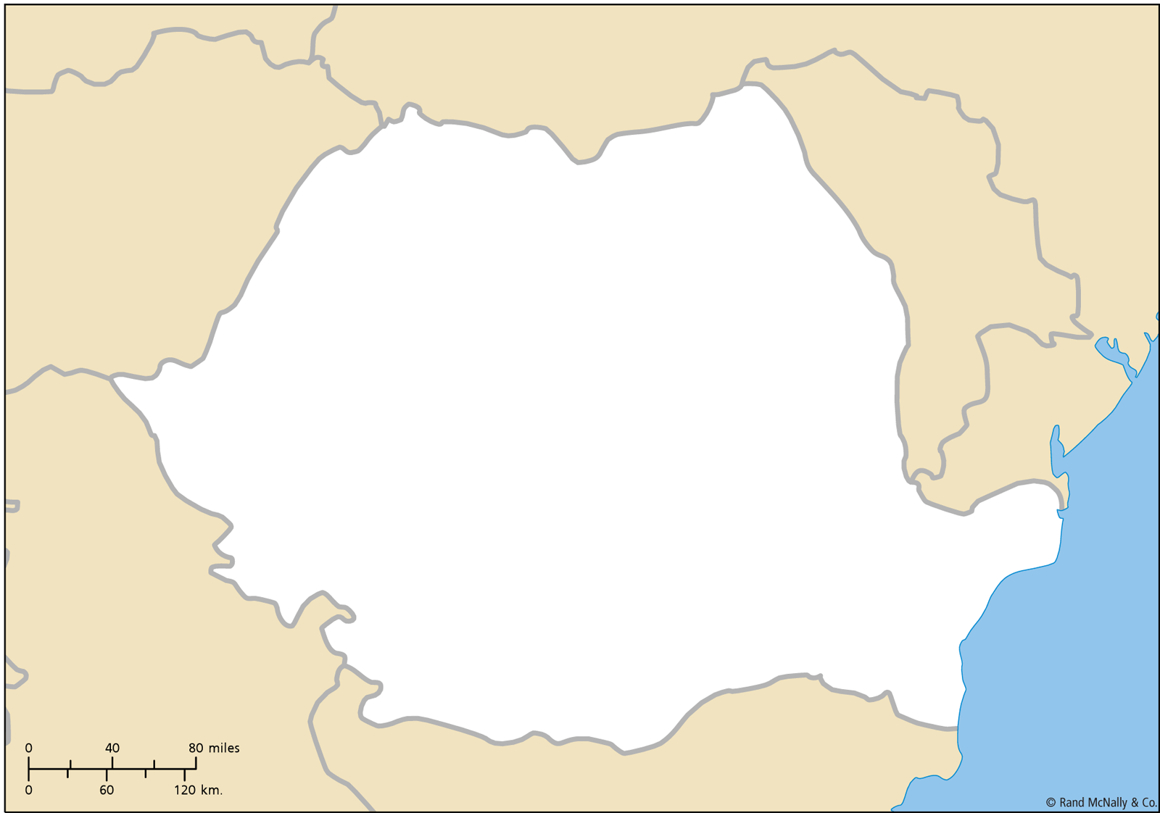

Slide 8
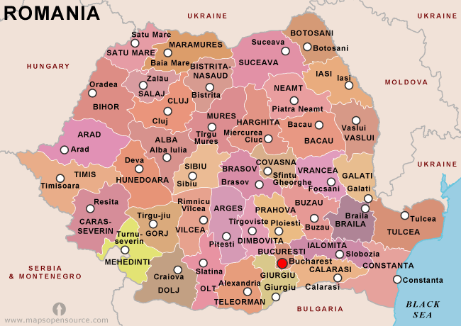

Slide 9
Example: Romania
On holiday in Romania; currently in Arad.
Flight leaves tomorrow from Bucharest
Formulate goal:
be in Bucharest
Formulate problem:
states: various cities
actions: drive between cities
Find solution:
sequence of cities, e.g., Arad, Sibiu, Fagaras, Bucharest

Slide 10
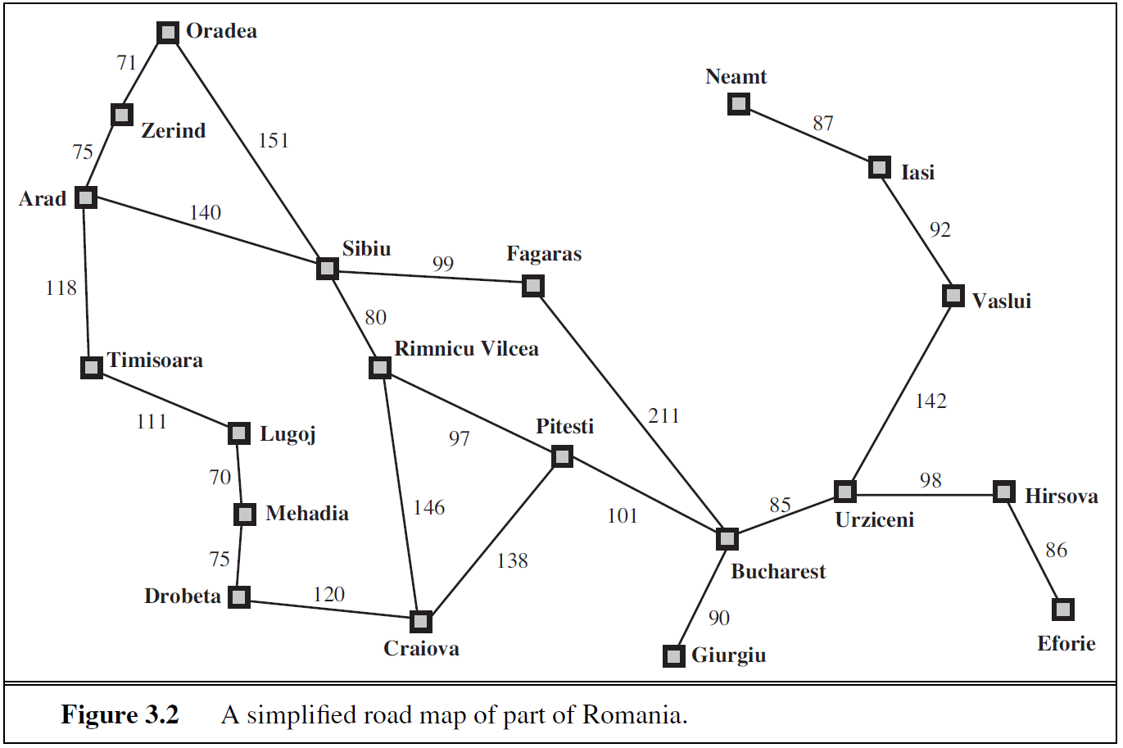
Example: Romania

Slide 11
Problem Types
Deterministic, fully observable → single-state problem
Agent knows exactly which state it will be in; solution is a sequence
Non-observable → sensorless problem (conformant problem)
Agent may have no idea where it is; solution is a sequence
Nondeterministic and/or partially observable → contingency problem
percepts provide new information about current state
often interleave search, execution
Unknown state space → exploration problem

Slide 12
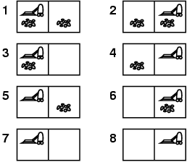
Example: Vacuum World
Single-state, start in #5. Solution?

Slide 13
Example: Vacuum World
Single-state, start in #5. Solution? [Right, Suck]
Sensorless, start in {1,2,3,4,5,6,7,8} e.g., Right goes to {2,4,6,8} Solution?

Slide 14
Example: Vacuum World
Sensorless, start in {1,2,3,4,5,6,7,8} e.g., Right goes to {2,4,6,8} Solution? [Right,Suck,Left,Suck]
Contingency
Nondeterministic: Suck may dirty a clean carpet
Partially observable: location, dirt at current location.
Percept: [L, Clean], i.e., start in #5 or #7 Solution?

Slide 15
Example: Vacuum World
Sensorless, start in {1,2,3,4,5,6,7,8} e.g., Right goes to {2,4,6,8} Solution? [Right,Suck,Left,Suck]
Contingency
Nondeterministic: Suck may dirty a clean carpet
Partially observable: location, dirt at current location.
Percept: [L, Clean], i.e., start in #5 or #7 Solution? [Right, if dirt then Suck]

Slide 16
Single-state problem formulation
A problem is defined by four items:
initial state e.g., "at Arad"
actions or successor function S(x) = set of action–state pairs
e.g., S(Arad) = {<Arad → Zerind, Zerind>, … }
goal test, can be
explicit, e.g., x = "at Bucharest"
implicit, e.g., Checkmate(x)
path cost (additive)
e.g., sum of distances, number of actions executed, etc.
c(x,a,y) is the step cost, assumed to be ≥ 0
A solution is a sequence of actions leading from the initial state to a goal state

Slide 17
Selecting a State Space
Real world is absurdly complex
→ state space must be abstracted for problem solving
(Abstract) state = set of real states
(Abstract) action = complex combination of real actions
e.g., "Arad → Zerind" represents a complex set of possible routes, detours, rest stops, etc.
For guaranteed realizability, any real state "in Arad“ must get to some real state "in Zerind"
(Abstract) solution = set of real paths that are solutions in the real world
Each abstract action should be "easier" than the original problem

Slide 18
Reflex Agent Solution
Precompute all paths from any start state to the final state
Store these paths in a table
When faced with a new instance of the problem, look up the answer in the table

Slide 19
Cops and Robbers
Three cops and three robbers come to a river and find a boat that holds two. If the robbers ever outnumber the cops on either bank, the robbers will overpower the cops and escape.
What is the strategy to cross the river without letting the robbers escape?

Slide 20
Cops and Robbers
State representation?
Start State?
End State?
Transitions?

Slide 21
Cops and Robbers
State representation?
Number of cops on the source bank
Number of robbers on the source bank
Number of boats on the source bank
Start State?
End State?
Transitions?
How many states total?
Some states are forbidden
Some states are unreachable

Slide 22
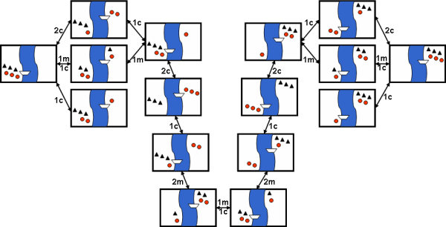
Cops and Robbers
Search space
Image from Gerhard Wickler

Slide 23
Cops and Robbers
Solution
Is a reflex agent the right method for this problem?
Idea: separate algorithm/model from problem description
Idea: planning agent

Slide 24
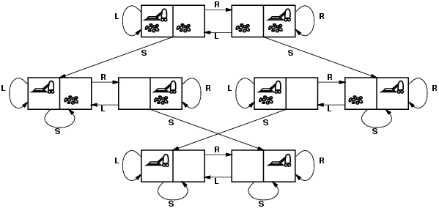
Vacuum world state space graph
states?
actions?
goal test?
path cost?

Slide 25
State Space Graph
states? integer dirt and robot location
actions? Left, Right, Suck
goal test? no dirt at all locations
path cost? 1 per action

Slide 26
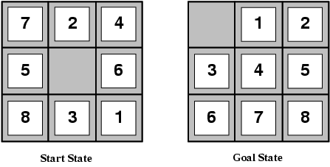
Example: The 8-puzzle
states?
actions?
goal test?
path cost?

Slide 27
Example: The 8-puzzle
states? locations of tiles
actions? move blank left, right, up, down
goal test? = goal state (given)
path cost? 1 per move [Note: optimal solution of n-Puzzle family is NP-hard]

Slide 28
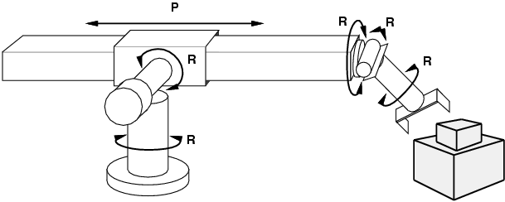
Example: Robotic Assembly
states?: real-valued coordinates of robot joint angles parts of the object to be assembled
actions?: continuous motions of robot joints
goal test?: complete assembly
path cost?: time to execute

Slide 29
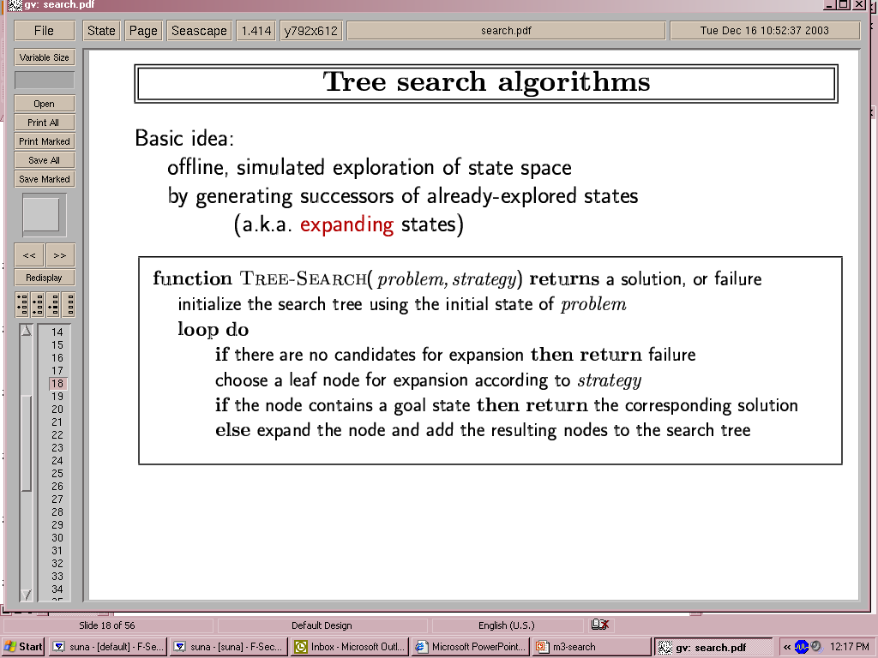
Tree Search Algorithms
Basic idea:
offline, simulated exploration of state space by generating successors of already-explored states (a.k.a.~expanding states)

Slide 30
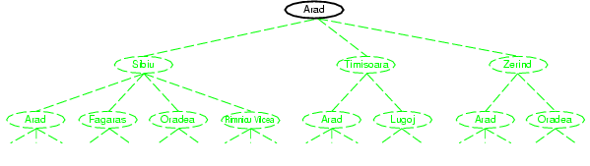
Tree search example

Slide 31
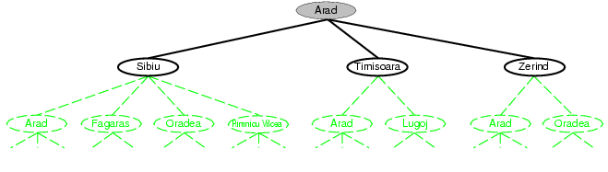
Tree search example

Slide 32
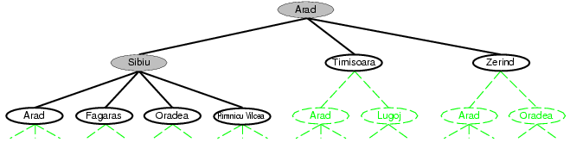
Tree search example

Slide 33
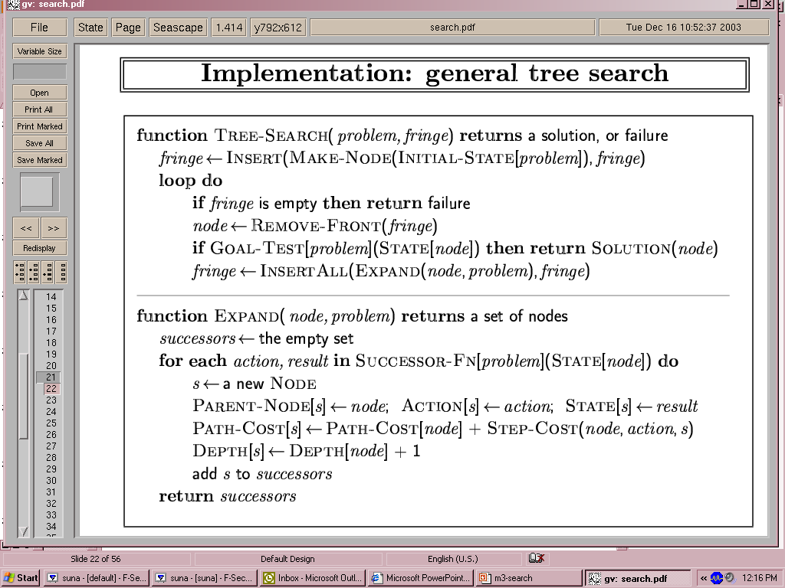
Implementation: general tree search

Slide 34
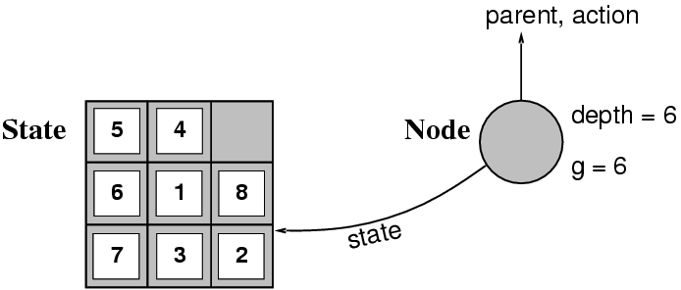
Implementation: states vs. nodes
A state is a (representation of) a physical configuration
A node is a data structure constituting part of a search tree includes state, parent node, action, path cost g(x), depth
The Expand function creates new nodes, filling in the various fields and using the SuccessorFn of the problem to create the corresponding states.

Slide 35
Search Strategies
A search strategy is defined by picking the order of node expansion
Strategies are evaluated along the following dimensions:
completeness: does it always find a solution if one exists?
time complexity: number of nodes generated
space complexity: maximum number of nodes in memory
optimality: does it always find a least-cost solution?
Time and space complexity are measured in terms of
b: maximum branching factor of the search tree
d: depth of the least-cost solution
m: maximum depth of the state space (may be ∞)

Slide 36
Uninformed search strategies
Uninformed search strategies use only the information available in the problem definition
Breadth-first search
Uniform-cost search
Depth-first search
Depth-limited search
Iterative deepening search

Slide 37
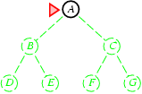
Breadth-first search
Expand shallowest unexpanded node
Implementation:
fringe is a FIFO queue, i.e., new successors go at end

Slide 38
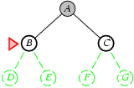
Breadth-first search
Expand shallowest unexpanded node
Implementation:
fringe is a FIFO queue, i.e., new successors go at end

Slide 39
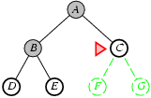
Breadth-first search
Expand shallowest unexpanded node
Implementation:
fringe is a FIFO queue, i.e., new successors go at end

Slide 40
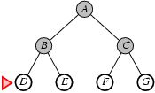
Breadth-first search
Expand shallowest unexpanded node
Implementation:
fringe is a FIFO queue, i.e., new successors go at end

Slide 41
Properties of breadth-first search
Complete? Yes (if b is finite)
Time? 1+b+b²+b³+… +b^{d} + b(b^{d}-1) = O(b^{d+1})
Space? O(b^{d+1}) (keeps every node in memory)
Optimal? Yes (if cost = 1 per step)
Space is the bigger problem (more than time)

Slide 42
Uniform-cost search
Expand least-cost unexpanded node
Implementation:
fringe = queue ordered by path cost
Equivalent to breadth-first if step costs all equal
Complete? Yes, if step cost ≥ ε
Time? # of nodes with g ≤ cost of optimal solution, O(b^{ceiling(C*/ ε)}) where C* is the cost of the optimal solution
Space? # of nodes with g ≤ cost of optimal solution, O(b^{ceiling(C*/ ε)})
Optimal? Yes – nodes expanded in increasing order of g(n)

Slide 43
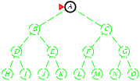
Depth-first search
Expand deepest unexpanded node
Implementation:
fringe = LIFO queue, i.e., put successors at front

Slide 44
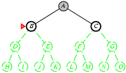
Depth-first search
Expand deepest unexpanded node
Implementation:
fringe = LIFO queue, i.e., put successors at front

Slide 45
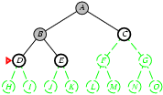
Depth-first search
Expand deepest unexpanded node
Implementation:
fringe = LIFO queue, i.e., put successors at front

Slide 46
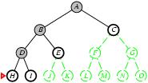
Depth-first search
Expand deepest unexpanded node
Implementation:
fringe = LIFO queue, i.e., put successors at front

Slide 47
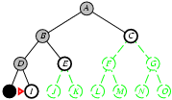
Depth-first search
Expand deepest unexpanded node
Implementation:
fringe = LIFO queue, i.e., put successors at front

Slide 48
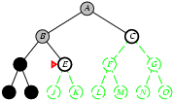
Depth-first search
Expand deepest unexpanded node
Implementation:
fringe = LIFO queue, i.e., put successors at front

Slide 49
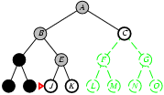
Depth-first search
Expand deepest unexpanded node
Implementation:
fringe = LIFO queue, i.e., put successors at front

Slide 50
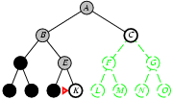
Depth-first search
Expand deepest unexpanded node
Implementation:
fringe = LIFO queue, i.e., put successors at front

Slide 51
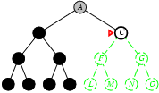
Depth-first search
Expand deepest unexpanded node
Implementation:
fringe = LIFO queue, i.e., put successors at front

Slide 52
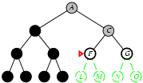
Depth-first search
Expand deepest unexpanded node
Implementation:
fringe = LIFO queue, i.e., put successors at front

Slide 53
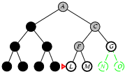
Depth-first search
Expand deepest unexpanded node
Implementation:
fringe = LIFO queue, i.e., put successors at front

Slide 54
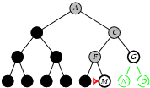
Depth-first search
Expand deepest unexpanded node
Implementation:
fringe = LIFO queue, i.e., put successors at front

Slide 55
Properties of depth-first search
Complete? No: fails in infinite-depth spaces, spaces with loops
Modify to avoid repeated states along path
→ complete in finite spaces
Time? O(b^{m}): terrible if m is much larger than d
but if solutions are dense, may be much faster than breadth-first
Space? O(bm), i.e., linear space!
Optimal? No

Slide 56
Demos
https://www.cs.usfca.edu/~galles/visualization/DFS.html
https://www.cs.usfca.edu/~galles/visualization/BFS.html
https://www.cs.usfca.edu/~galles/visualization/Algorithms.html
http://www.redblobgames.com/pathfinding/a-star/introduction.html
http://www.greenfoot.org/scenarios/4900

Slide 57
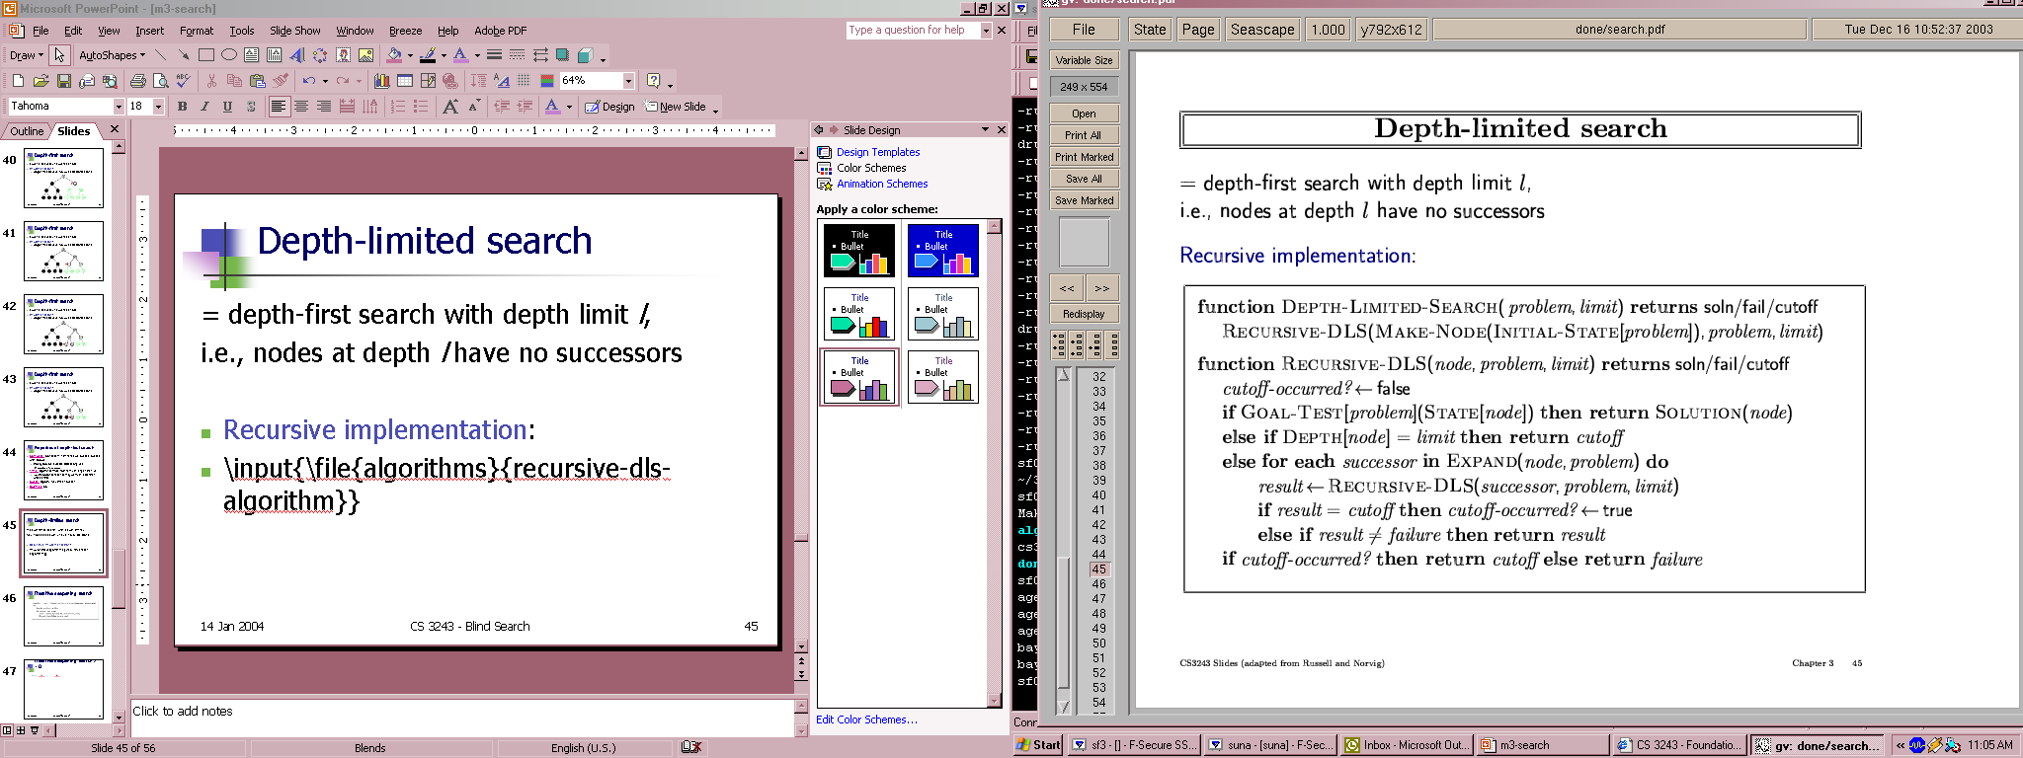
Depth-limited search
= depth-first search with depth limit l,
i.e., nodes at depth l have no successors
Recursive implementation:

Slide 58
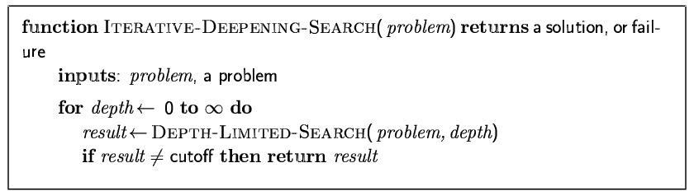
Iterative deepening search

Slide 59
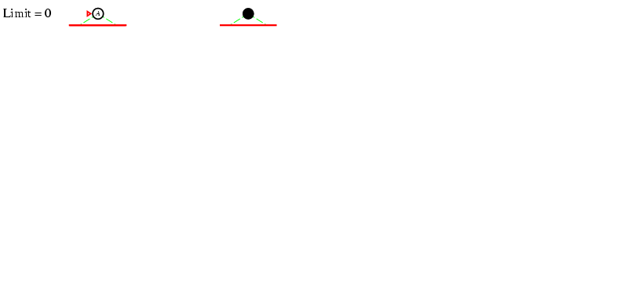
Iterative deepening search l =0

Slide 60
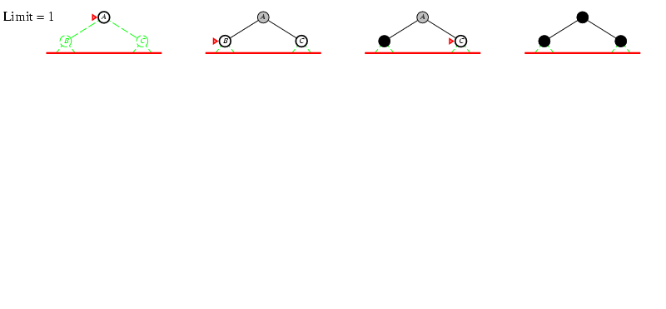
Iterative deepening search l =1

Slide 61
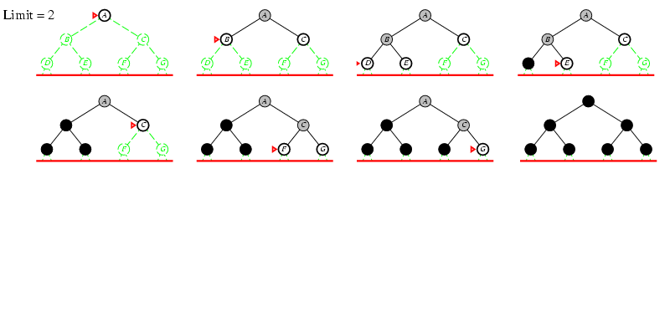
Iterative deepening search l =2

Slide 62
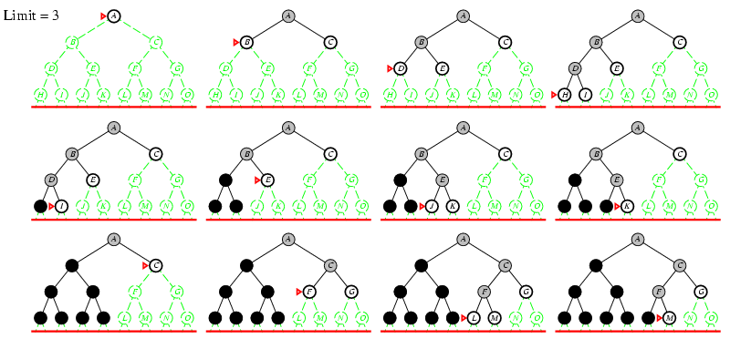
Iterative deepening search l =3

Slide 63
Iterative deepening search
Number of nodes generated in a depth-limited search to depth d with branching factor b:
N_{DLS} = b⁰ + b¹ + b² + … + b^{d-2} + b^{d-1} + b^{d}
Number of nodes generated in an iterative deepening search to depth d with branching factor b:
N_{IDS} = (d+1)b⁰ + d b^¹ + (d-1)b^² + … + 3b^{d-2} +2b^{d-1} + 1b^{d}
For b = 10, d = 5,
N_{DLS} = 1 + 10 + 100 + 1,000 + 10,000 + 100,000 = 111,111
N_{IDS} = 6 + 50 + 400 + 3,000 + 20,000 + 100,000 = 123,456
Overhead = (123,456 - 111,111)/111,111 = 11%

Slide 64
Properties of iterative deepening search
Complete? Yes
Time? (d+1)b⁰ + d b¹ + (d-1)b² + … + b^{d} = O(b^{d})
Space? O(bd)
Optimal? Yes, if step cost = 1

Slide 65
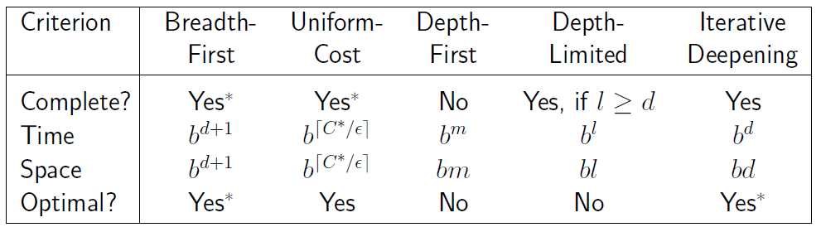
Summary of algorithms

Slide 66
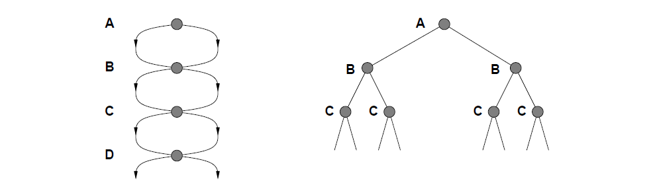
Repeated states
Failure to detect repeated states can turn a linear problem into an exponential one!

Slide 67
Dynamic Programming
Split the problem of computing the total cost from Start state to End state into:
Past cost to current state S_{i}
Future cost from S_{i} to end state
The future cost is equal to 0 at the final state
In other states:
Consider all possible actions a_{j}
Pick the one that minimizes
Cost (S_{i}, a_{j}) + Future Cost (successor(S_{i}, a_{j}))

Slide 68
Dynamic Programming
How to avoid exponential costs?
By storing all relevant history in the description of the current state
Romania example:
The future cost of a node doesn’t depend on the path that got us there
In this case, the current node only needs to store the best cost that got us there
DP rule: if the best past cost has been computed for a node, don’t compute it again

Slide 69
Dynamic Programming Demos
https://www.cs.usfca.edu/~galles/visualization/DPFib.html
https://www.cs.usfca.edu/~galles/visualization/DPLCS.html
https://blast.ncbi.nlm.nih.gov/Blast.cgi?PAGE_TYPE=BlastSearch&PROG_DEF=blastn&BLAST_PROG_DEF=blastn&BLAST_SPEC=GlobalAln&LINK_LOC=BlastHomeLink
http://experiments.mostafa.io/public/needleman-wunsch/
https://zhanglab.ccmb.med.umich.edu/NW-align/
https://zhanglab.ccmb.med.umich.edu/FASTA/
http://www.cs.yale.edu/homes/radev/nlpclass/slides2017/313.pdf

Slide 70
Sample Protein Sequence
>gi|186681228|ref|YP_001864424.1| phycoerythrobilin:ferredoxin oxidoreductase
MNSERSDVTLYQPFLDYAIAYMRSRLDLEPYPIPTGFESNSAVVGKGKNQEEVVTTSYAFQTAKLRQIRA
AHVQGGNSLQVLNFVIFPHLNYDLPFFGADLVTLPGGHLIALDMQPLFRDDSAYQAKYTEPILPIFHAHQ
QHLSWGGDFPEEAQPFFSPAFLWTRPQETAVVETQVFAAFKDYLKAYLDFVEQAEAVTDSQNLVAIKQAQ
LRYLRYRAEKDPARGMFKRFYGAEWTEEYIHGFLFDLERKLTVVK
Nucleic acid codes:
A --> adenosine M --> A C (amino) C --> cytidine S --> G C (strong) G --> guanine W --> A T (weak) T --> thymidine B --> G T C U --> uridine D --> G A T R --> G A (purine) H --> A C T Y --> T C (pyrimidine) V --> G C A K --> G T (keto) N --> A G C T (any)
Amino acid codes:
A ALA alanine P PRO proline B ASX aspartate or asparagine Q GLN glutamine C CYS cystine R ARG arginine D ASP aspartate S SER serine E GLU glutamate T THR threonine F PHE phenylalanine U selenocysteine G GLY glycine V VAL valine H HIS histidine W TRP tryptophan I ILE isoleucine Y TYR tyrosine K LYS lysine Z GLX glutamate or glutamine L LEU leucine X any M MET methionine * translation stop N ASN asparagine - gap of indeterminate length

Slide 71
Uniform Cost Search
Dynamic programming only works when the graph is acyclic
The assumption is that we will compute the past cost of a state before computing the past cost of its successors.
This doesn’t work for general graphs

Slide 72
Uniform Cost Search
The idea of uniform cost search is to order the states by past cost
Not the same as Dijkstra’s algorithm because the graph may not be fully specified at search time
Furthermore, UCS is intended to find the best cost path only from the start state to the goal state, not between all pairs of states.

Slide 73
Uniform Cost Search
Explored states – cost known
Frontier states – known states but cost is unknown
Unexplored states – the rest

Slide 74
Dijkstra Algorithm
https://en.wikipedia.org/wiki/Dijkstra%27s_algorithm#/media/File:Dijkstra_Animation.gif
By Ibmua - Work by uploader., Public Domain, https://commons.wikimedia.org/w/index.php?curid=6282617

Slide 75
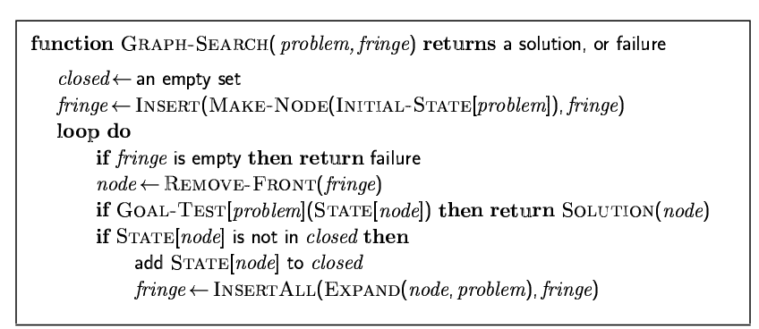
Graph Search

Slide 76
Dijkstra Demos
https://www.cs.usfca.edu/~galles/visualization/Dijkstra.html
https://qiao.github.io/PathFinding.js/visual/
https://visualgo.net/de/sssp?slide=1

Slide 77
Learning the Costs
The solution depends on the costs
If the costs are given, fine
What if they are not?
This is a learning problem (the inverse of search)
Observed sequence of actions -> costs
Sample algorithm
Structured perceptron (later)

Slide 78
Summary
Problem formulation usually requires abstracting away real-world details to define a state space that can feasibly be explored
Variety of uninformed search strategies
Iterative deepening search uses only linear space and not much more time than other uninformed algorithms

Slide 79
AI

